Slide 2
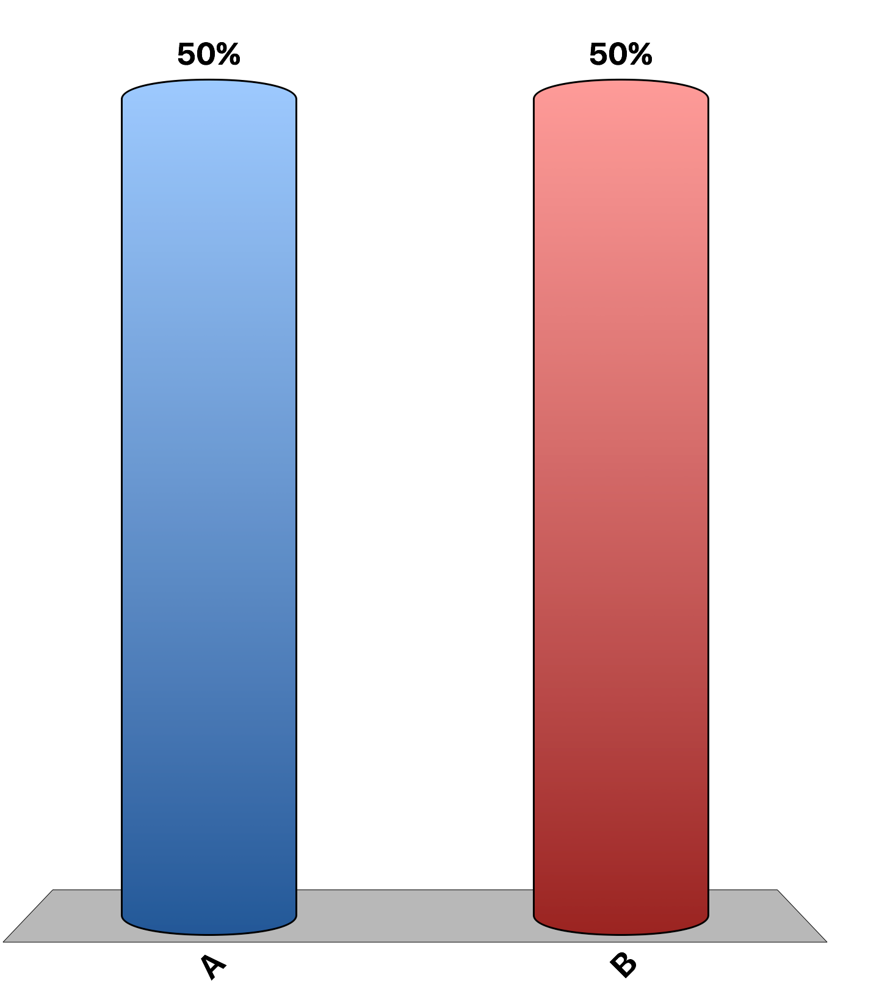
Economists consider monopolies to be inefficient because they can earn profits in the long run.
True
False

Slide 3
In equilibrium, the relationship between price (P), marginal revenue (MR), and marginal cost (MC) for a monopoly is: P < MR = MC.
True
False

Slide 4
A natural monopoly can supply a good to the entire market at a lower cost than two or more firms could.
True
False

Slide 5
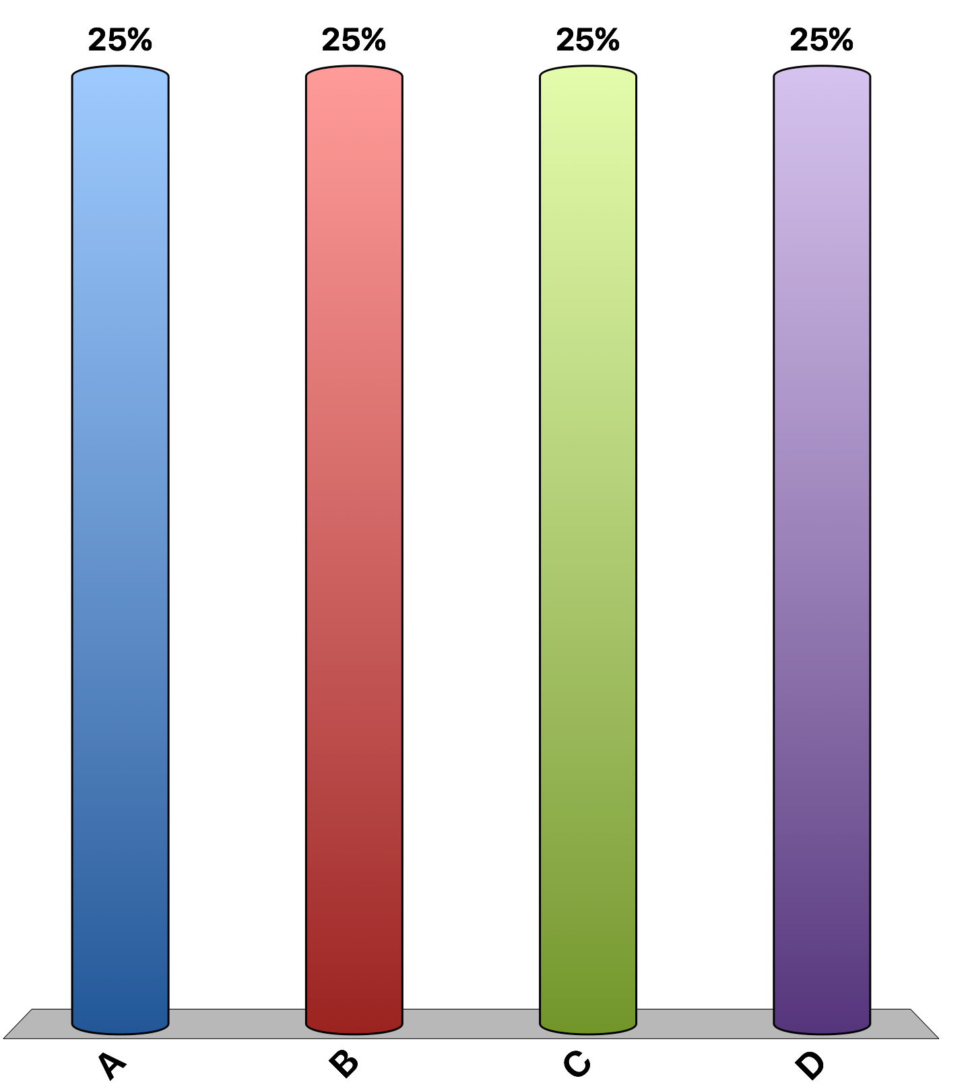
In comparison to a perfectly competitive firm, a monopolist charges a
higher price and produces a higher quantity.
higher price and produces a lower quantity.
lower price and produces a higher quantity.
lower price and produces a lower quantity.

Slide 6
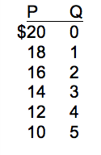
Refer to the table which illustrates the demand curve for a monopolist. Suppose the firm’s marginal cost is constant at $5, and there are no fixed costs. This monopolist will produce
5 units of output and charge a price of $10.
4 units of output and charge a price of $12.
3 units of output and charge a price of $14.
2 units of output and charge a price of $16.

Slide 7
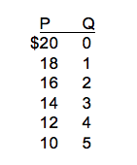
Refer to the table which illustrates the demand curve for a monopolist. Suppose the firm’s marginal cost is constant at $5, and there are no fixed costs. By producing the profit-maximizing output, this monopolist will earn total profits of
$12.
$27.
$28.
$37.

Slide 8
Suppose that a monopolist is producing a level of output such that marginal revenue exceeds marginal cost. To increase profits, this monopolist should
increase output and increase price.
decrease output and decrease price.
increase output and decrease price.
decrease output and increase price.

Slide 9
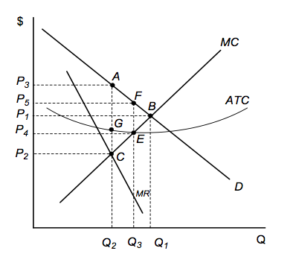
Refer to the figure. This monopolist will charge a price of:
P₅ and produce quantity Q₃
P₂ and produce quantity Q₂
P₁ and produce quantity Q₁
P₃ and produce quantity Q₂

Slide 10
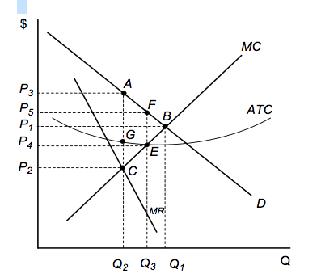
Refer to the figure. The deadweight loss for a profit-maximizing monopolist is the area ________, and the profit per unit is the distance______.
ABEG; AF.
ABC; AG.
FBE; FE.
GEC; BE.

Slide 11
Perfect price discrimination
raises profit.
raises total surplus.
lowers consumer surplus.
All of the above are correct.

Slide 12
Which of the following is not an example of price discrimination?
Nabisco provides cents-off coupons for Oreos.
Amtrak offers a lower price for weekend travel compared to weekday rates on the same routes.
Hotel rates are lower for AAA members than for nonmembers.
Lamb’s wool sweaters are less expensive than cashmere sweaters.

Slide 13
When a movie theater offers a discounted ticket price to moviegoers over the age of 65, it engages in
price discrimination and increases the deadweight loss.
price discrimination and decreases the deadweight loss.
revenue maximization and decreases the deadweight loss.
perfect price discrimination and decreases the deadweight loss.

Slide 14
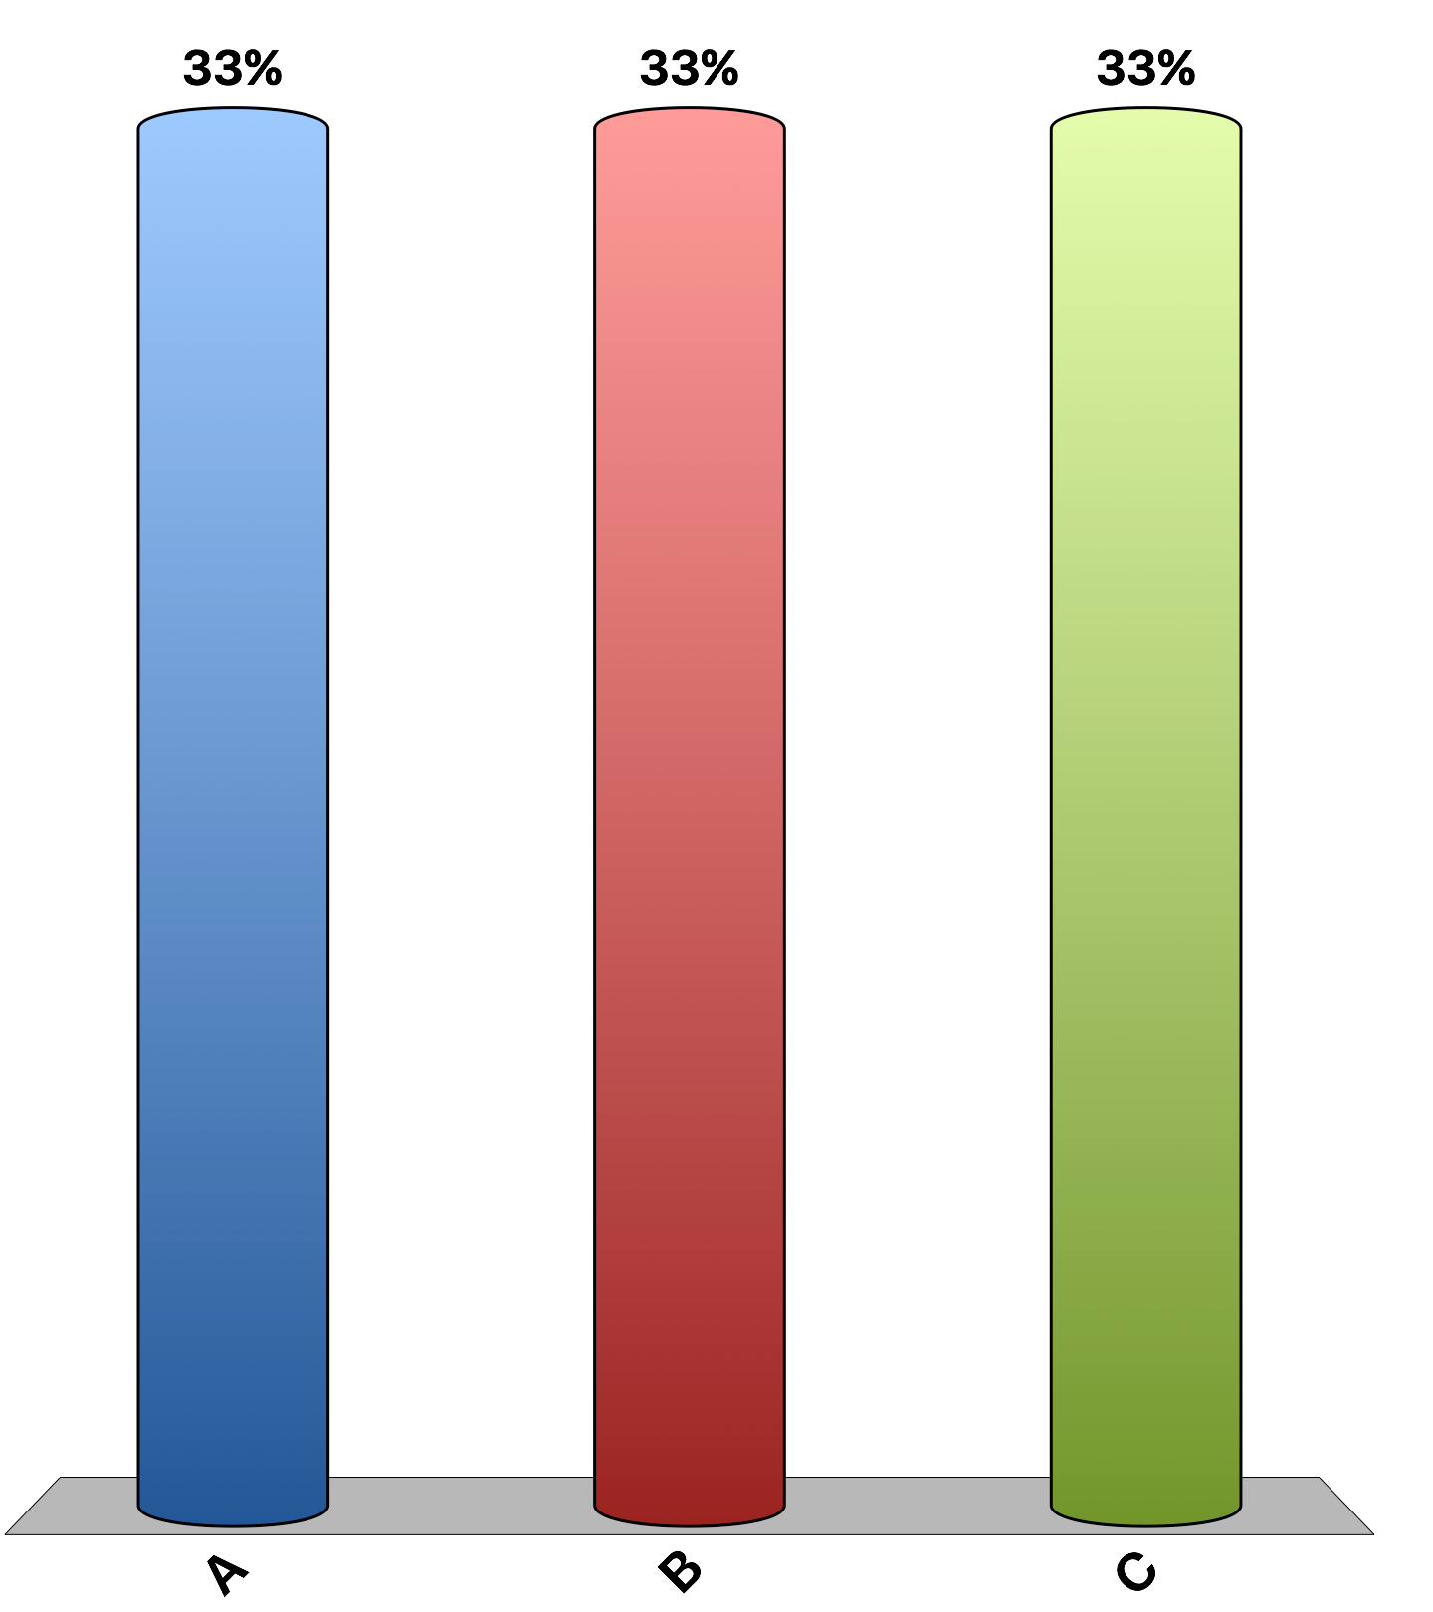
“If regulators had not approved mergers in the past decade between major networked airlines, travelers would be better off today.”
agree
disagree
uncertain
Notes:
29% of economists agree; 26% disagree; and 45% are uncertain. This is the 'Ask the experts' feature in the textbook. Source: IGM Economic Experts Panel, August 28, 2013.

